Slide 1
Area of a circle and sectors
By the Friendly Neighbourhood Mathematics Department

Slide 2
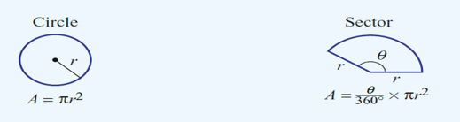
Basic Circle and Sector formula
EQ: When is a circle not a circle?

Slide 3
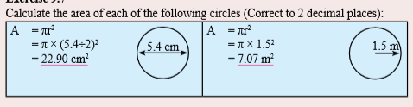


Slide 4
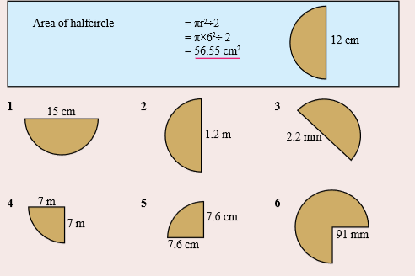
Finding a semi circle, three quarter circle and a quarter circle

Slide 5
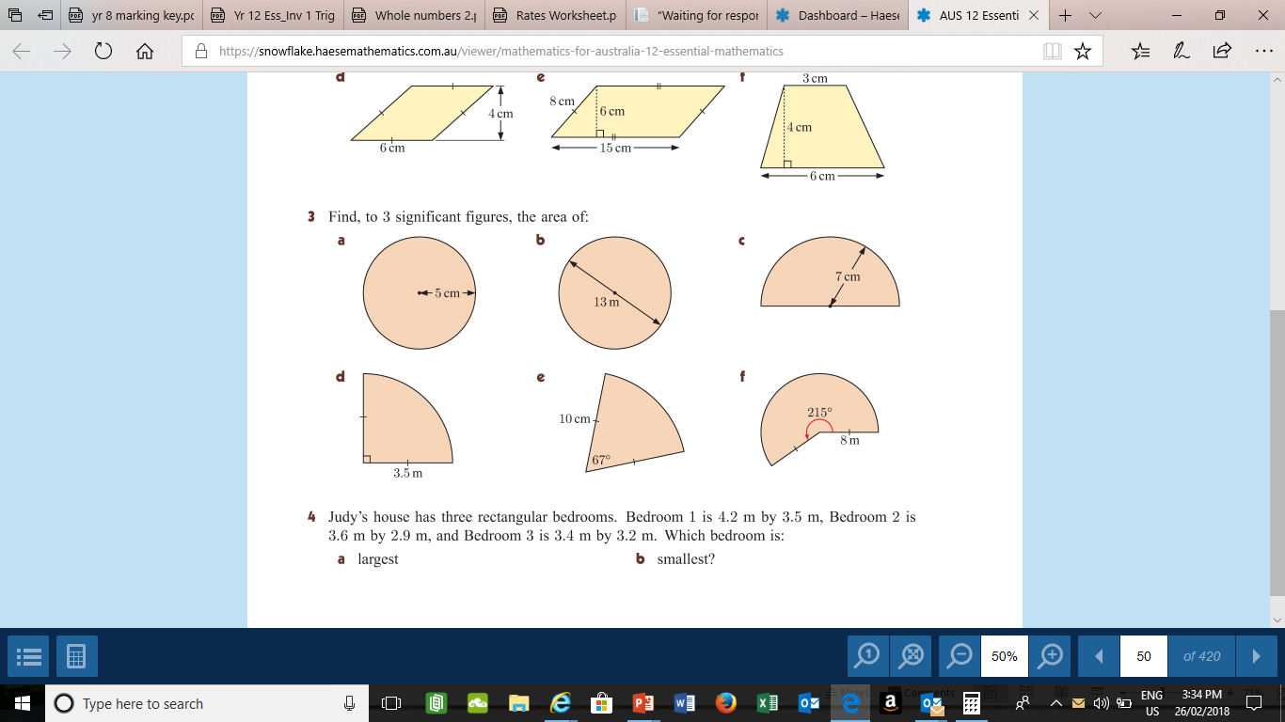
Sectors.

Slide 6
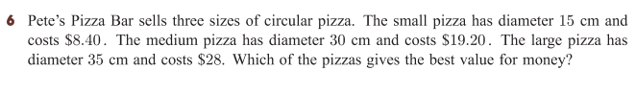
Bonus Question:

